Slide 1
Introduction to Stochastic Models II
Cristina Lanzas and Shi Chen
CBS 810 Infectious disease modeling

Slide 2
Learning objectives
Learn basic steps of Gillespie’s algorithm for continuous time Markov chain model
Compare and contrast the difference between stochastic and deterministic models
Explain the effects of demographic stochasticity on disease dynamics

Slide 3

Chain Binomial Model – Example of DTMC
Only TOTAL infected individuals are simulated:
The probability of x infected individuals in the generation t+1 has binomial probability (q=1-p so this is binomial):
Update the infected individual at t+1
St+1=St-It+1
Rt+1=N-It+1-St+1 (optional)
Notes:
Discrete time model; only deals with 2/3 states; cannot handle.

Slide 4
From Discrete to Continuous Time
Continuous Time Markov Chain (CTMC):
Time is continuous in [0, inf)
Most Important Questions:
WHEN does next event happen?
WHAT is the next event?

Slide 5
Gillespie’s Algorithm: An Event-Driven Method
1. List all possible events and associate rates
2. Randomly select the time and next event:
Calculate the total rate
Simulate next event according to the rate
Compare the rate of each event and decide which occurs
3. Update the system state
4. Repeat

Slide 6
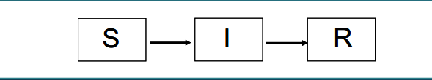
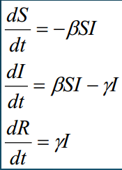
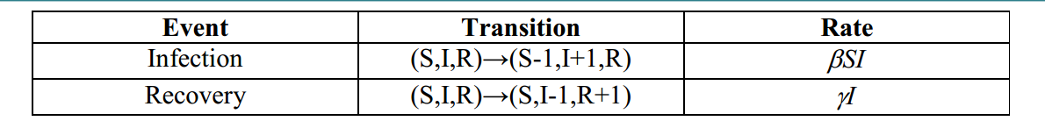
Example of Gillespie’s Algorithm
An example of simple SIR model w/o demography
The deterministic counterpart of the SIR model
1. List all possible events and the rate at which they occur

Slide 7
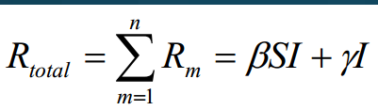
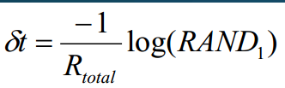
Example of Gillespie’s Algorithm: WHEN does the next event occurs?
2.1 Calculate the TOTAL rates at which an event occurs
2.2 Simulate the time an event occurs
RAND: an uniformly distributed random number
Notes:
Recall the ODE describes “rate of change”

Slide 8
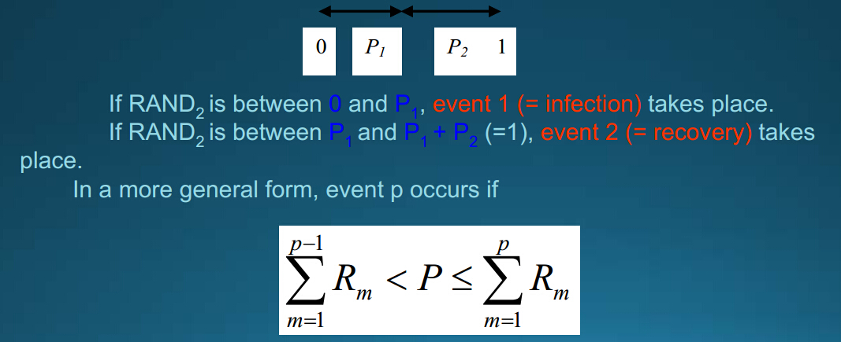
Example of Gillespie’s Algorithm: WHAT is the next event?
2.3 Determine which event occurs
2.3.1 Calculate relative probability of each rate: Ri/Rtotal
Sum of all relative probability is thus 1.
2.3.2 Generate a new uniformly distributed random variable RAND2 and compare with the relative probability.
Notes:
Recall the ODE describes “rate of change”

Slide 9
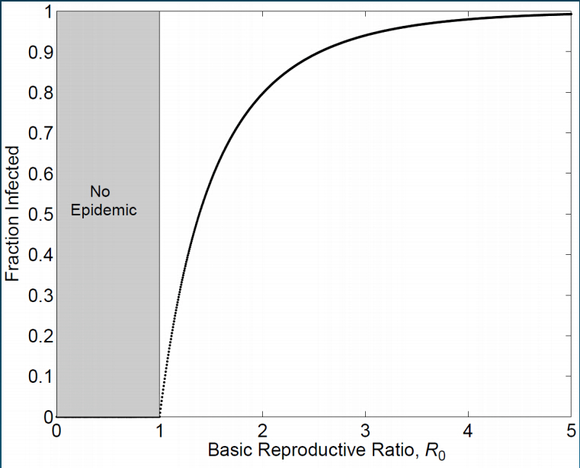
Stochastic Effects in Epidemics
In stochastic models:
When Ro<1, transmission and outbreak can still occur
When R0>1, transmission and outbreak can still die out
In Deterministic models:

Slide 10
Disease Extinction
Endemic extinction/fadeout: random fluctuations around endemic equilibrium can cause extinction of disease – the disease-free equilibrium is an absorbing state (black hole)
Pext=1/R0
Epidemic extinction/fadeout: depletion of susceptible pol and pathogen runs out of susceptible individuals (“susceptible bottleneck”)

Slide 11
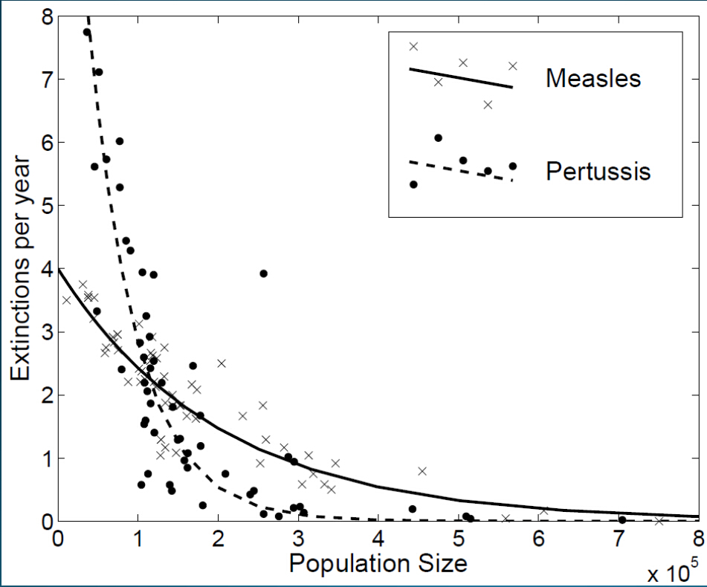
Critical Community Size
The smallest population size that does not suffer disease extinction (in biologically realistic/reasonable time)
Example: measles ~ 400,000 (Ro=1.8)

